Slide 1
Table of Contents – Machine Learning
WIP
Part1 Overview
Choosing right algorithm 7/18
Type of learnings 7/20
Parametric vs. Non Parametric Model 9/20
Algorithm one pager 9/20 Merging
Framework to learn algorithms 7/20, 9/20
Hyperparameter tuning 9/20
Online learning -- starting
Part2 Algorithms – Math, Parameters
Cost Function 7/20
Gradient Descent 7/20
Normal equation 7/20
Linear regression 8/7
Logistic regression 7/20
Multiclass classification 7/20
Support vector machine 8/3 - Math
K-nearest neighbor 8/6, 9/15
Decision Tree 7/16, 7/18, 9/20
Random Forest 7/16, 9/20
Ensemble 8/6, 9/20
Neural network 8/7 – Back prop
Dimensionality reduction (PCA) 8/6 - SVD
Clustering 8/6
Naïve Bayes 8/6, 9/20
Part3 Model Evaluation
Work Flow of DS Project 7/20
Performance metrics summary 7/20
Confusion matrix 7/19
ROC curve 7/14
Bias and Variance 7/19
Overfitting 7/20
Learning curves 8/5
Complexity curves
Cross validation 7/19
Regularization 7/20
Regularization (L1, L2) 8/6
Part4 Others
Univariate, Bivariate and Multivariate analysis
Imputation (treatment of missing values)
Handling of imbalanced data – 7/21
Outliner treatment – 7/21
Feature transformation (min-max, standardization)
Box cox transformation
Treatment of categorical variables

Slide 2
Considerations when choosing an algorithm
Target values/ objectives
Data: Size, # of features, quality, and nature of the data
Accuracy: Getting the most accurate possible isn’t always necessary.
Training time: When time is limited it can drive the choice of algorithm, especially when the data set is large.
Linearity: Lots of learning algorithms make use of linearity.
Number of parameters: The time required to train a model to tune parameters can increase exponentially with the number of parameters

Slide 3
Classification1: Type of learnings
Supervised learning
The machine learning task of inferring a function from labeled training data. Supervised learning is where you have input variables (x) and an output variable (Y) and you use an algorithm to learn the mapping function from the input to the output. The goal is to approximate the mapping function so well that when you have new input data(x) that you can predict the output variables (Y) for that data.
Classification: the output variable is a category, such as “red” and “blue” or “malignant” and “benign”
Regression: the output variable is a real value, such as “dollars” or “weight”
Unsupervised learning
Data points have no labels associated with them. Instead, the goal of an unsupervised learning algorithm is to organize the data in some way or to describe its structure. E.g. Clustering
Reinforcement learning
The algorithm gets to choose an action in response to each data point. The learning algorithm also receives a reward signal a short time later, indicating how good the decision was. Based on this, the algorithm modifies its strategy in order to achieve the highest reward

Slide 4
Classification2: Similarity in form of function
Regression Algorithms
Instance-based Algorithms
Regularization Algorithms
Decision Tree Algorithms
Bayesian Algorithms
Clustering Algorithms
Association Rule Learning Algorithms
ANN Algorithms
Deep Learning Algorithms
Dimensionality Reduction Algorithms
Notes:
http://machinelearningmastery.com/a-tour-of-machine-learning-algorithms/

Slide 5
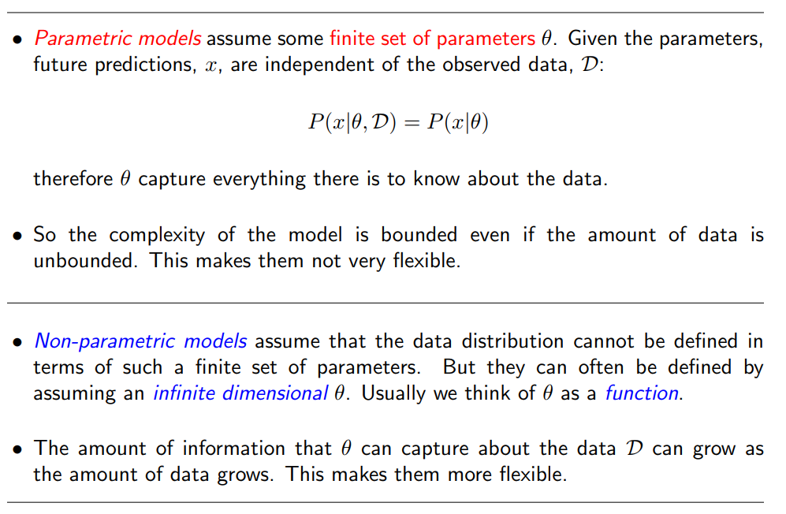
Parametric vs. Non Parametric Model
 | Parametric | Non-parametric
Training | Slow | No
Prediction | Fast | Slow
Memory | Only parameters | Whole dataset
Online learning | Need to retrain | Add new data to memroy

Slide 6
CHOOSING THE RIGHT ALGORITHM – Merge with next slide
 | Linear Regression | Decision Tree | Random Forest | Neural networks | SVMs | KNN | Naïve Bayes
 | Regression | Classification | Classification/ Regression | Classification/ Regression | Classification/Regression | Classification/ Regression | Classification
Use case | The first look at dataset Baseline predictions Numerical data with lots of features | The first look at dataset Credit risk analysis | The first look at dataset Apt at almost any machine learning problem | Image reconigtion Speech recognition Vision recognition Robotics | Feature intense data, like text or genomic | Computer vision Recommender systems Multi-label tagging Spell checking problems | Text classification Spam detection Real time prediction
Pros | Very fast Easy to understand the model Seldom overfits Using L1 & L2 regularization is effective in feature slection | Fast Robust to noise and missing values Easy to understand the model | Less prone to overfitting Can model complex relationships Handles high dimensional spaces as well as large number of training examples Automatically handles missing values No need to transform any variable | Powerful Can model very complex relationships Robust to outliers | Can model complex, nonlinear relationships Robust to noise Handles highly dimensional space well Higher accuracy | Simple No training involved(lazy) Canhandle extreme multiclass problems (like tagging text) Easy to interpret output | Avoid overfitting Very few parameters Simple Easy and fast to implement, doesn’t require too much memory and can be used for online learning Takes into account prior knowledge Useful for very large data sets Easy to obtain the estimated probability for a prediction
Cons | Unable to model complex relationships Unable to capture nonlinear relationships without first transforming the inputs Can suffer from outliers | Prone to overfitting | Difficult to interpret Biased in multiclass problems toward more frequent classes | Prone to overfitting Long training time Requires significant computing power for large datasets Model is unreadable Difficult to set up Difficult to tune because of too many parameters and you have also to decide the architecture of the network | Requires significant memory and processing power (Inefficient to train) Suffers from too many examples, after 10,000 examples it starts taking too long to train Need to select a good kernel function No standardized way for dealing with multi-class problems; fundamentally a binary classifier | Expensive and slow to predict new instances Must define a meaningful distance function Requires dimension reduction ( e.g. with more than 10 dimensions) | Fails estimating rare occurrences Strong and unrealistic feature independence assumptions(however, in reality, it works) Suffers from irrelevant features
Key words | Explanation tool Not a prediction tool L1 & L2 regularization Lniearity Heterokedasticity Multicollinearity | Split: Gini, Entropy, Information gain Nonparametric model Tree structure (noted, leaf, split, ) Inductive bias(restrictor bias, preference bias) | Feature importance Out of bag error Boosting Ensemble | Back propagation | Kernel Trick Margin | Lazy learner Instance based learning Nonparametric model Distance function (Euclidean, Manhattan) Locality | Prior probability (dot) Test evidence => Posterior probability conditional independence assumption Zero frequency
Parameters to tune |  | Max_depth Min_samples_split Min_samples_leaf | Number of trees Max features |  | Kernel C Gammas <= what is this? | N_neighbors P <= what is this?

Slide 7
CHOOSING THE RIGHT ALGORITHM
Algorithm | Best at | Pros | Cons
Random Forest | Apt at almost any machine learning problem Bioinformatics | - Can work in parallel - Seldom overfits - Automatically handles missing values - No need to transform any variable - No need to tweak parameters - Can be used by almost anyone with excellent results | - Difficult to interpret - Weaker on regression when estimating values at the extremities of the distribution of response values - Biased in multiclass problems toward more frequent classes
Gradient Boosting | - Apt at almost any machine learning problem - Search engines (solving the problem of learning to rank) | - It can approximate most nonlinear function - Best in class predictor - Automatically handles missing values - No need to transform any variable | - It can overfit if run for too many iterations - Sensitive to noisy data and outliers - Doesn’t work well without parameter tuning
Linear regression | - Baseline predictions - Econometric predictions - Modelling marketing responses | - Simple to understand and explain - It seldom overfits - Using L1 & L2 regularization is effective in feature selection - Fast to train - Easy to train on big data thanks to its stochastic version | - You have to work hard to make it fit nonlinear functions - Can suffer from outliers
Support Vector Machines | - Character recognition - Image recognition -Text Classification | - Automatic nonlinear feature creation - Can approximate complex nonlinear functions | - Difficult to interpret when applying nonlinear kernels - Suffers from too many examples, after 10,000 examples it starts taking too long to train
K-nearest Neighbors | - Computer vision - Multilabel tagging - Recommender systems - Spell checking problems | - Fast, lazy training - Can naturally handle extreme multiclass problems (like tagging text) | - Slow and cumbersome in the predicting phase - Can fail to predict correctly due to the curse of dimensionality
Adaboost | Face detection | - Automatically handles missing values - No need to transform any variable - It doesn’t overfit easily - Few parameters to tweak - It can leverage many different weak-learners | - Sensitive to noisy data and outliers - Never the best in class predictions
Naive Bayes | - Face recognition - Sentiment analysis - Spam detection - Text classification | - Easy and fast to implement, doesn’t require too much memory and can be used for online learning - Easy to understand - Takes into account prior knowledge | - Strong and unrealistic feature independence assumptions - Fails estimating rare occurrences - Suffers from irrelevant features
Neural Networks | - Image recognition - Language recognition and translation - Speech recognition - Vision recognition | - Can approximate any nonlinear function - Robust to outliers - Works only with a portion of the examples (the support vectors) | - Very difficult to set up - Difficult to tune because of too many parameters and you have also to decide the architecture of the network - Difficult to interpret - Easy to overfit
Logistic regression | - Ordering results by probability - Modelling marketing responses | - Simple to understand and explain - Using L1 & L2 regularization is effective in feature selection - It seldom overfits - The best algorithm for predicting probabilities of an event - Fast to train - Easy to train on big data thanks to its stochastic version | - You have to work hard to make it fit nonlinear functions - Can suffer from outliers
SVD | Recommender systems | - Can restructure data in a meaningful way | Difficult to understand why data has been restructured in a certain way
PCA | - Removing collinearity - Reducing dimensions of the dataset | - Can reduce data dimensionality | Implies strong linear assumptions (components are a weighted summations of features)
K-means | Segmentation | - Fast in finding clusters - Can detect outliers in multiple dimensions | - Suffers from multicollinearity - Clusters are spherical, can’t detect groups of other shape - Unstable solutions, depends on initialization
Notes:
http://www.dummies.com/programming/big-data/data-science/machine-learning-dummies-cheat-sheet/

Slide 8
Type of data vs. Algorithm
Numerical data | Linear regression Logistic regression Support vector machine K-NN K means clustering Tree-based model NN
Categorical data | Tree-based model Naïve bayes NN K-NN type with a cost function different than Euclidean distance e.g. hamming distance
Mix | Tree-based model

Slide 9
6+2 Questions To Understand Any ML Algorithm
How do you refer to the technique (e.g. what name)?
How do you represent a learned model (e.g. what coefficients)?
How do you learn a model (e.g. the optimization process from data to the representation)?
How do you make predictions from a learned model (e.g. apply the model to new data)?
How do you best prepare your data for the modeling with the technique (e.g. assumptions)?
How do you get more information on the technique (e.g. where to look)?
What problem is the technique suited for?
What are advantages and disadvantages of the technique?
Key words
Notes:
https://machinelearningmastery.com/question-to-understand-any-machine-learning-algorithm/

Slide 10
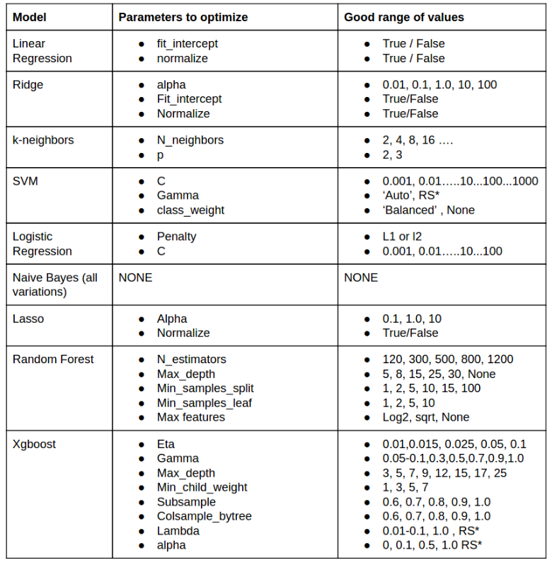
Hyperparameter tuning cheat sheet

Slide 11
Online learning

Slide 12
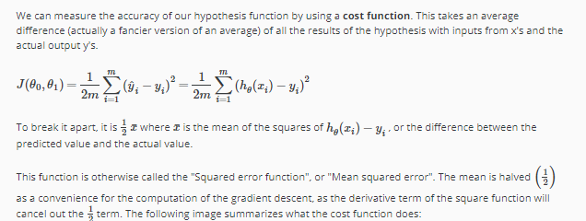
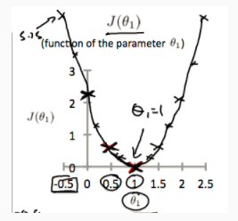
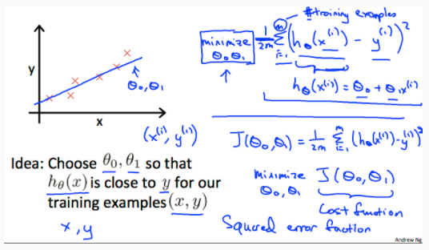
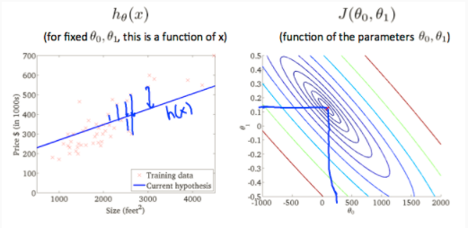
Cost Function

Slide 13
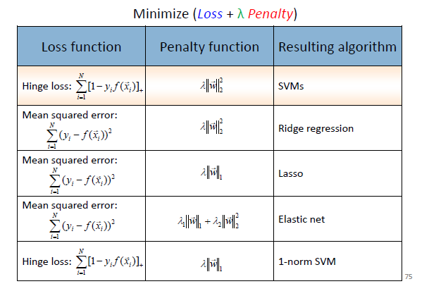
“Loss(cost) + penalty” framework

Slide 14
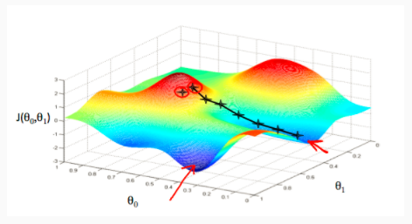
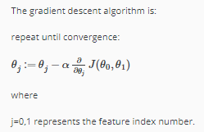
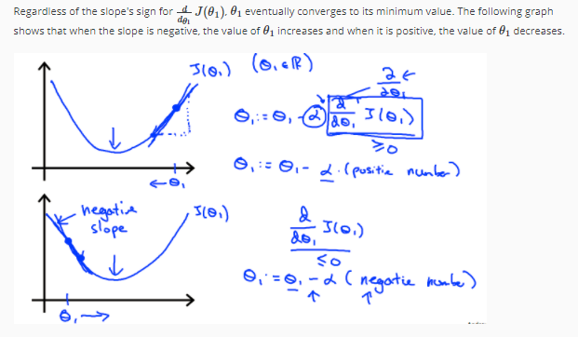
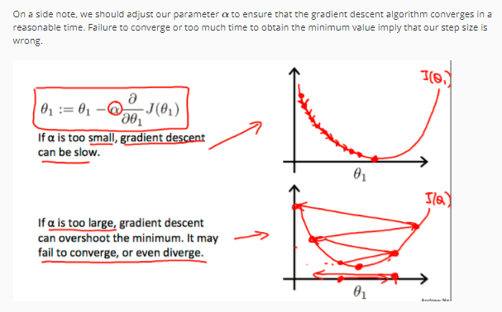
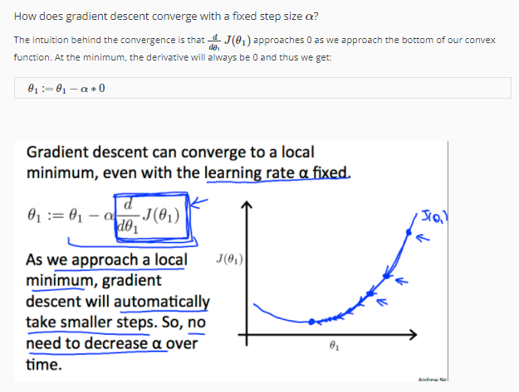
Gradient descent

Slide 15
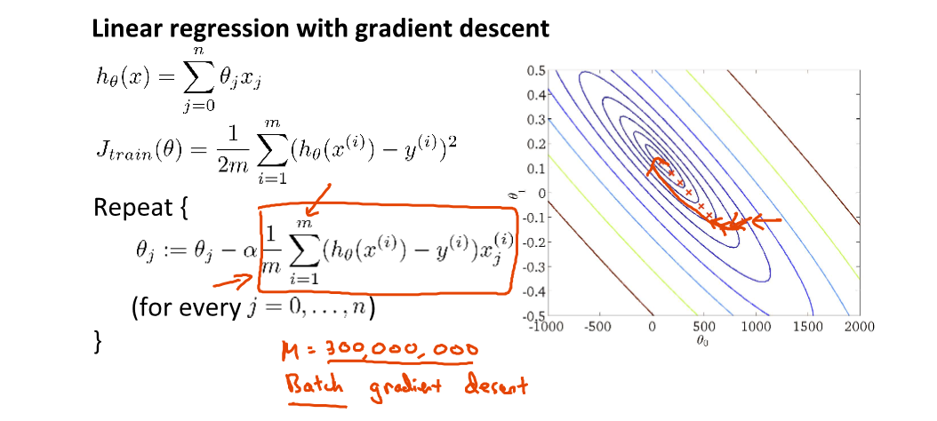
Problem of gradient descent
Computation for the summation gets expensive as it a number of training set grows

Slide 16
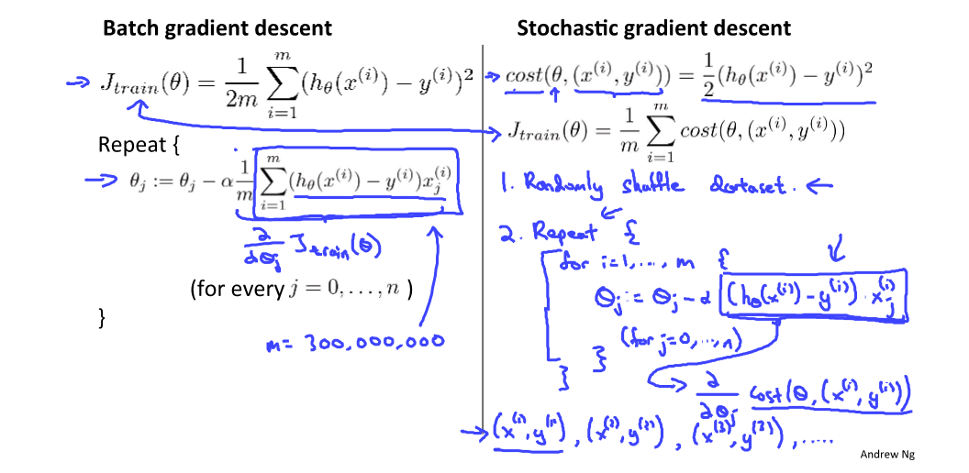
Stochastic gradient descent
So in other words, we're going to look at the first example and modify the parameters a little bit to fit just the first training example a little bit better. Having done this inside this inner for-loop is then going to go on to the second training example. And what it's going to do there is take another little step in parameter space, so modify the parameters just a little bit to try to fit just a second training example a little bit better. Having done that, is then going to go onto my third training example. And modify the parameters to try to fit just the third training example a little bit better, and so on until you know, you get through the entire training set.
So rather than, you know, waiting 'till taking a path through all 300,000 United States Census records, say, rather than needing to scan through all of the training examples before we can modify the parameters a little bit and make progress towards a global minimum. For Stochastic gradient descent instead we just need to look at a single training example and we're already starting to make progress in this case of parameters towards, moving the parameters towards the global minimum.

Slide 17
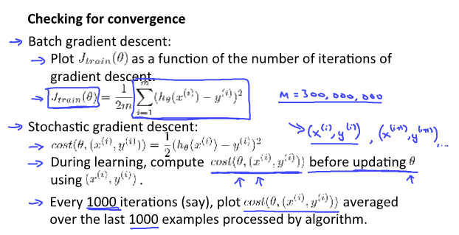
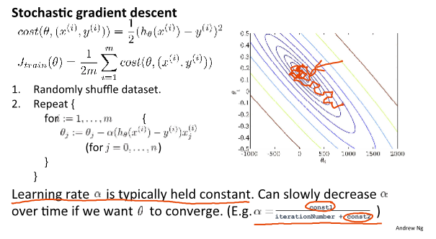
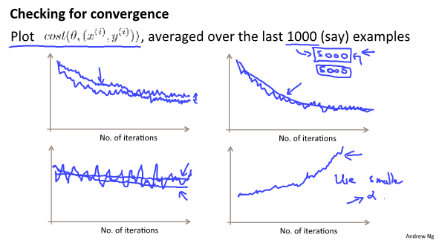
Stochastic gradient descent convergence
1. Make sure the algorithm is converging okay
2. Turn the learning rate alpha

Slide 18
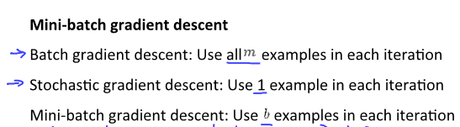
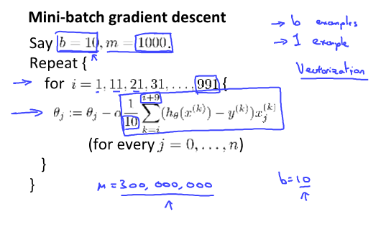
Mini-batch gradient descent
Why Mini-batch over Stochastic. Answer is Vectorization.
Mini-batch is likely to outperform Stochastic only if you have a good vectorized implementation which allow to partially parallelize computation.
(just looking at one example at a time their isn’t much to parallelize over for Stochastic gradient descent)
One disadvantage of Mini-batch gradient descent is to pick parameter b. 10 is common. Other values between 2 to 100 would be reasonably common

Slide 19
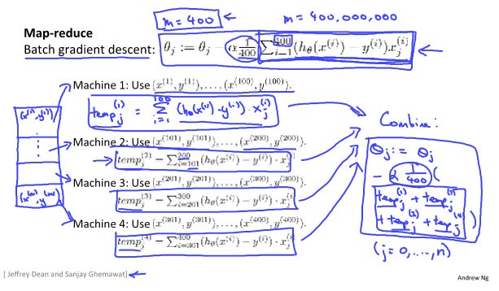
Map-reduce and data parallelism

Slide 20
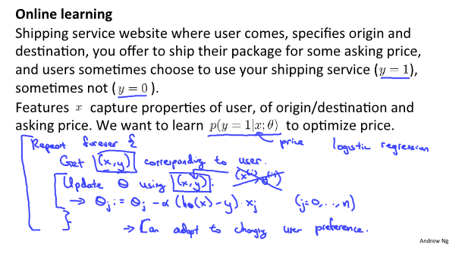
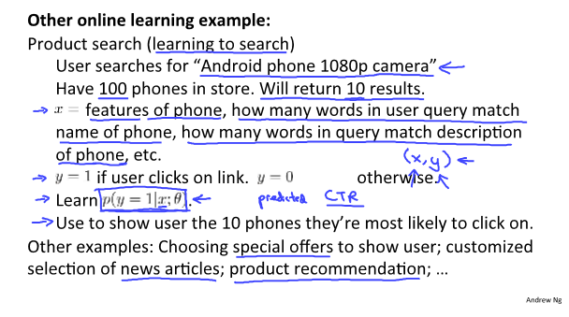
Online learning

Slide 21
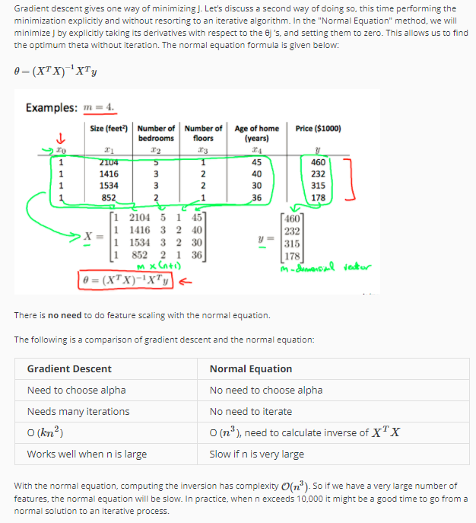
Normal Equation

Slide 22
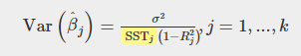
Linear regression
Motivation: The mean is a single point that summarize a set of data; a line is the next simplest way to summarize a set of data
The primary strength of regression analysis is being able to identify what factors affect that phenomenon and the magnitude of their effect.
Problem: Predict a value for specific feature based on the data-set
Assumptions: Linear relationship between the input variables with the output.
How to compute OLS estimators: Gradient Descent, Maximum Likelihood, Normal Equation, Moment conditions. Cost: Minimize SSR: Residual Sum of Squares.
How to evaluate OLS estimators: BLUE. “Best”: Smallest possible variance(efficient), “Unbiased”: The estimators are on average equal their true parameter values. “Linearity”: the estimates are derived using linear combinations of the data values.
OLS1: Linearity in model parameters
OLS2: Random sampling
OLS3: No perfect collinearity among variables
OLS4: Zero conditional mean OLS4’ Exogeneity
OLS5: Homoskedasticity: error has a constant variance => impacting on variance of OLS estimators
OLS6: Normality of error
Leverage and influence
Also check OLS Asymptotic (large sample properties)
Note: Slope coefficients tells the change in your dependent variable for a 1-unit change in the explanatory variable (simple regression)

Slide 23
Linear regression - continue
Model fit – R squared, Adjsuted R squared, Multiple R squared, AIC, BIC, note parsimonious model
Model specification:
Interpretation: note: ceteris paribus (holding all other variables constant)

Slide 24
Logistic Regression
Assumption
A linear relationship between the input variables with the output. In other words, input space can be separated into two regions by a linear(straight) boundary (this dividing plane is called a linear discriminant).
Learning:
After the initial training using the training data Logistic Regression gives each feature a weight according to their importance (weight = parameter = coefficient). This is achieved by minimizing a cost function. What the model optimizes (cost function): Penalize incorrect classification. E.g. If prediction is positive with greater confidence but is actually negative, penalize greater.
Prediction
When we are predicting we take all feature values multiply them with their weights accordingly
We then sum up all the results.
This final result is applied to a special function called Sigmoid/Logistic function which only outputs values between 0-1 which can be interpreted as the probability of our positive label.
Pro: Simple, Interpretability,
Con:
Notes:
Reference:
https://codesachin.wordpress.com/2015/08/16/logistic-regression-for-dummies/
http://machinelearningmastery.com/logistic-regression-for-machine-learning/
https://web.stanford.edu/class/psych252/tutorials/Tutorial_LogisticRegression.html

Slide 25
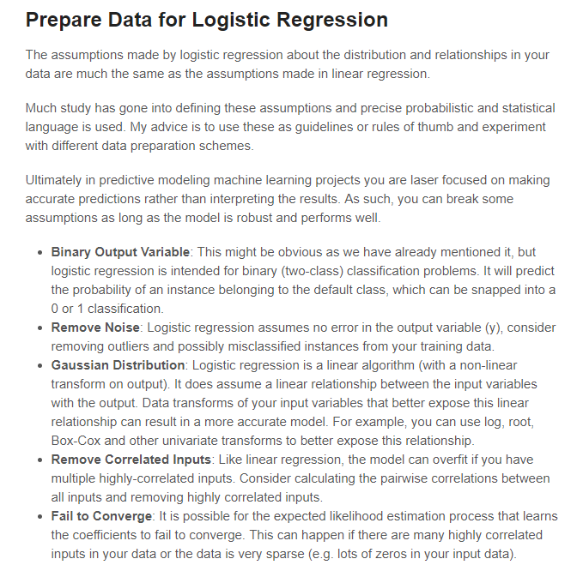
Same as the assumptions made in linear regression

Slide 26
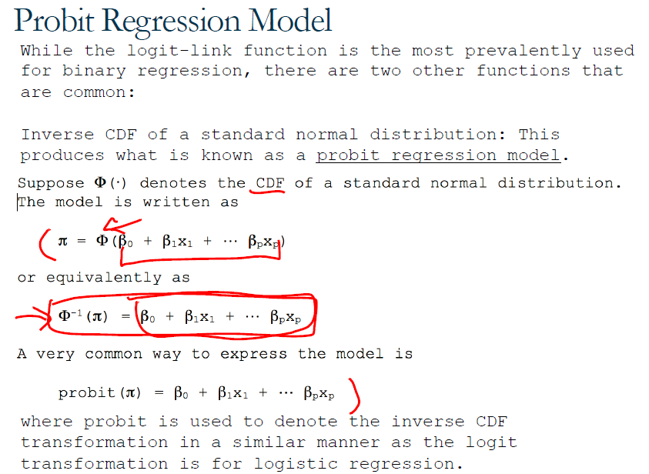

Slide 27
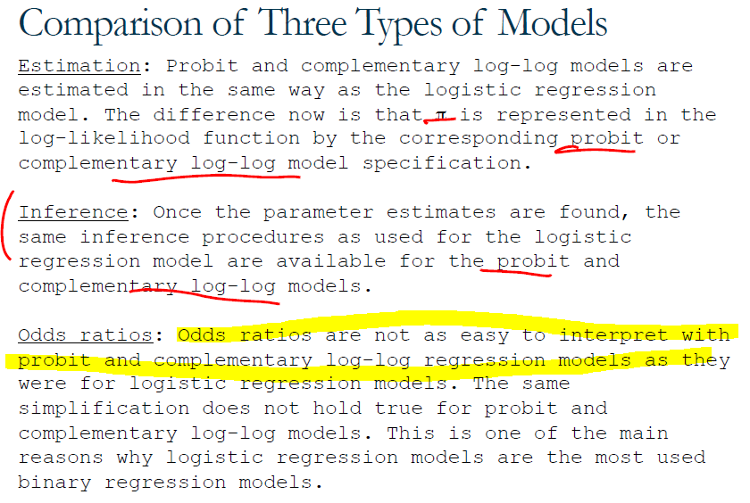
Why logit is the most popular

Slide 28
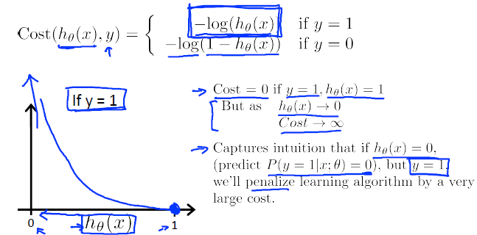
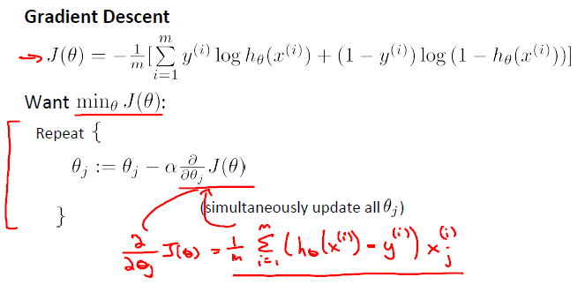
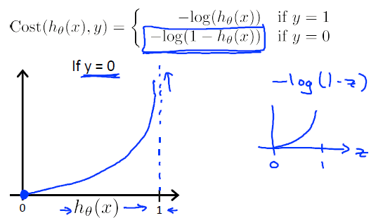
Log Loss Function (Logistic regression cost function)
Intuitive understanding!
If y = 1,
cost blows up if prediction h(x) = 0
cost is 0 if prediction h(x) = 1
If y = 0
Cost blows up if prediction h(x) = 1
Cost is 0 if prediction h(x) = 0

Slide 29
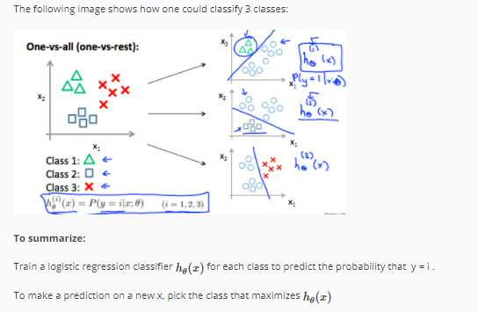
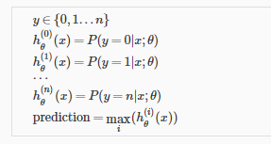
Multiclass classification: one-vs-all

Slide 30
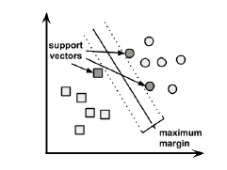
Support Vector Machine
https://med.nyu.edu/chibi/sites/default/files/chibi/Final.pdf
Assumptions: SVM learners require all features to be numeric, and each feature is called to a fairly small interval. We need to normalize or standardize the data.
Learning: After the initial training using the training data, SVM gives each feature a weight according to their importance. This is achieved by minimizing a cost function. What the model optimizes (cost function): The cost function maximizes margin between two hyperplane that separate positive class and negative class.
The case of non-linearly separable data --- kernel trick
Use case: Feature intense data such as text, genomic
Pros: Can model complex nonlinear relationships, robust to noise, handles highly dimensional space well. High accuracy
Cons: Suffers from too many examples (10,000>), memory and processing power
Parameters to tune:
Kernel, C (smaller => more regularization)
the parameter C plays a role similar to the regularization parameter (lambda) and helps to take into account outliers.

Slide 31
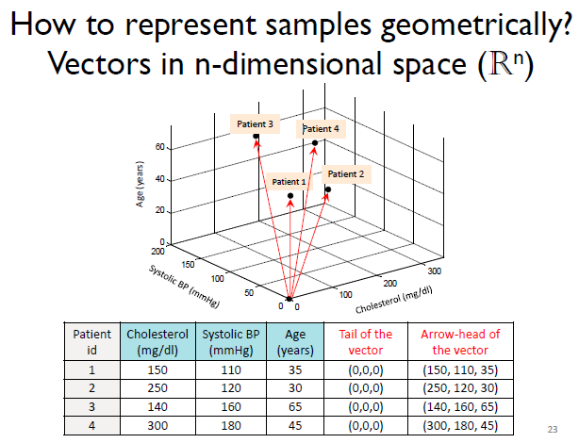
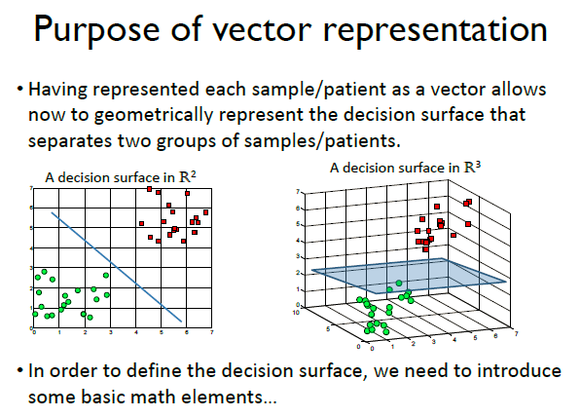
SVM – Detail 0

Slide 32
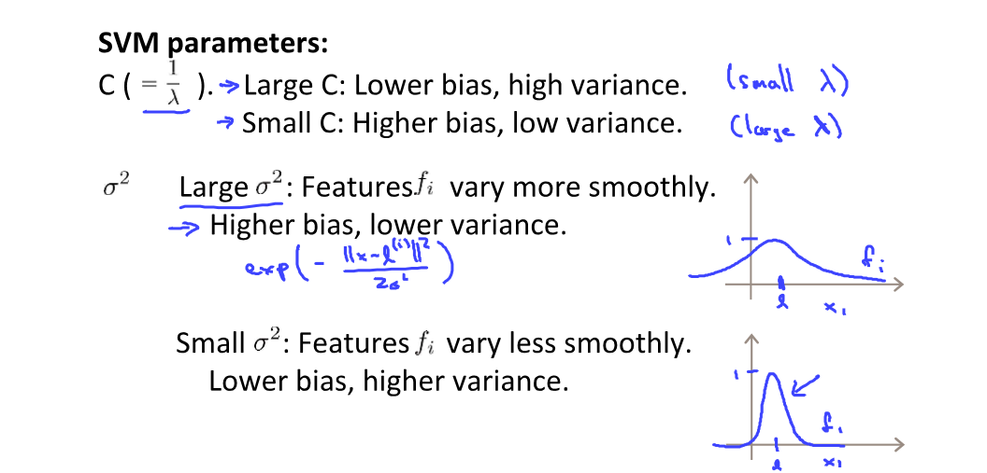
SVM Detail3 - Parameters

Slide 33
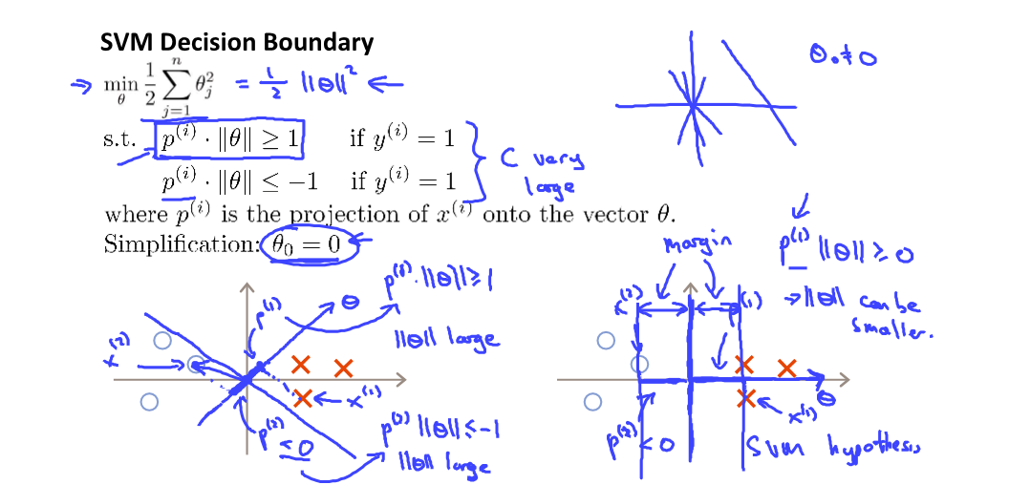
SVM Detail1 – Decision Boundary

Slide 34
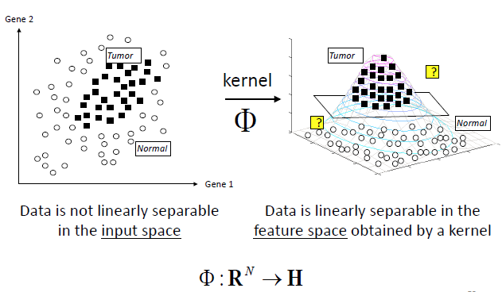
SVM Detail2 – Kernel for non-linearly separable data

Slide 35
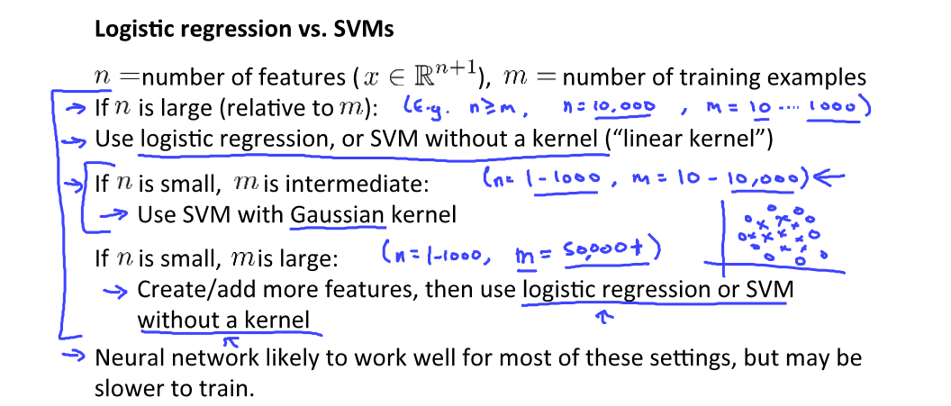
SVM Detail4 – Logistic regression vs. SMVs

Slide 36
Neural Network
Pick a network architecture. No. of input units: dimension of features, No. output units: number of classes. No. of layer (1 hidden layer to start). No. hidden units in every layer
Learning:
Randomly initialize weights
Forward prop to get h(x) for any x
Compute cost function J(theta)
Back prop to compute partial derivative of J(theta)
Use gradient checking to compute partial derivative of J(theta) and compare with the one computed by back prop
Use gradient descent or advanced optimization method with back prop to try to minimize J(theta) as a function of parameters theta

Slide 37
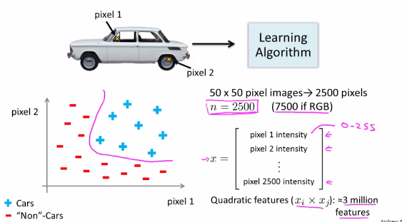
Motivation for Neural Networks

Slide 38
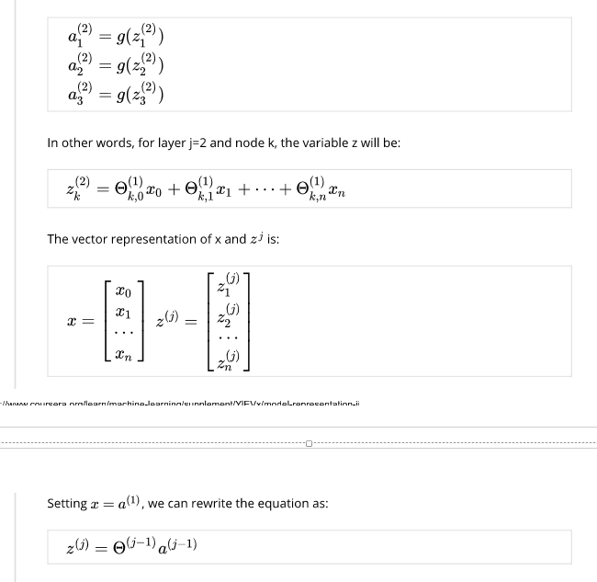
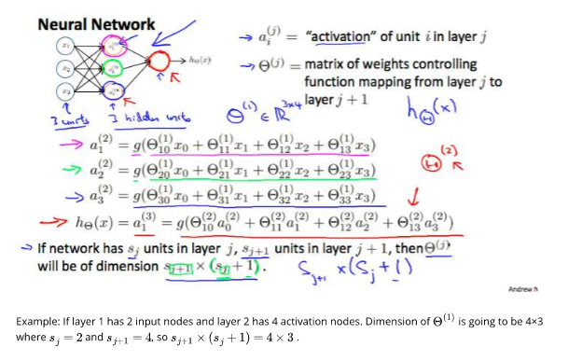
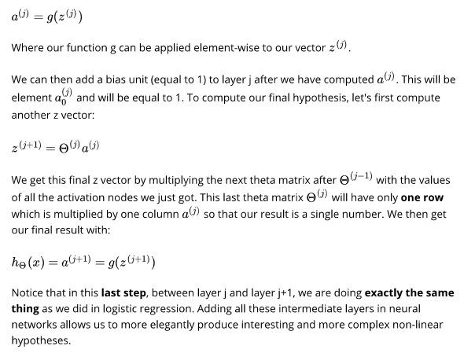
Neural Networks --- Notation

Slide 39
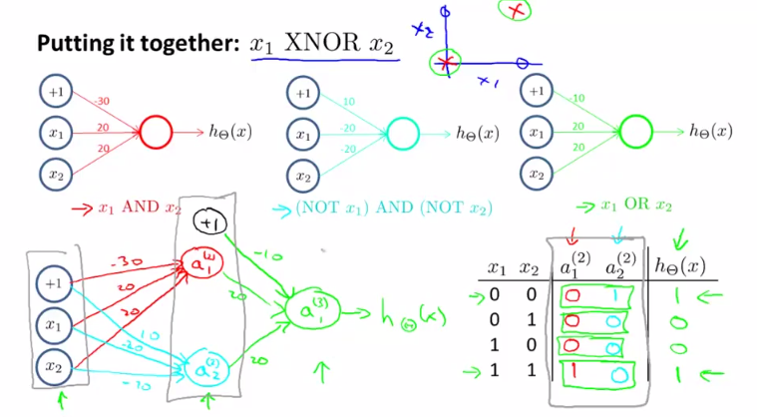
Neural Networks --- Example

Slide 40
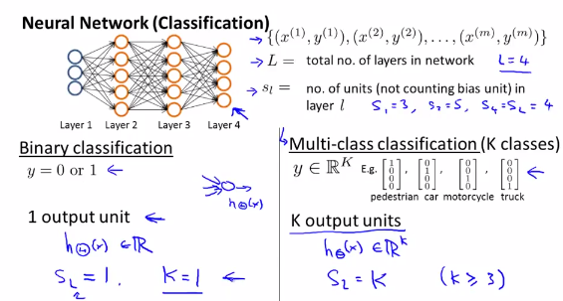
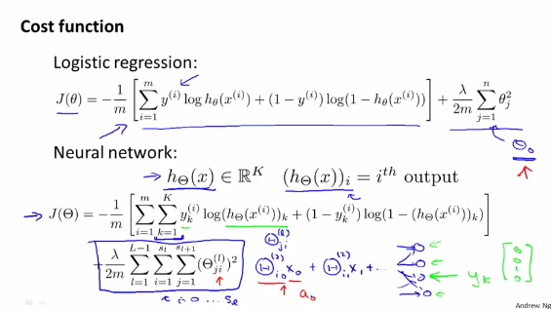
Neural Networks

Slide 41
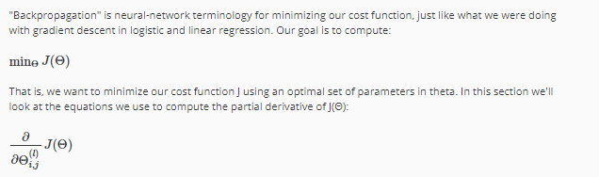
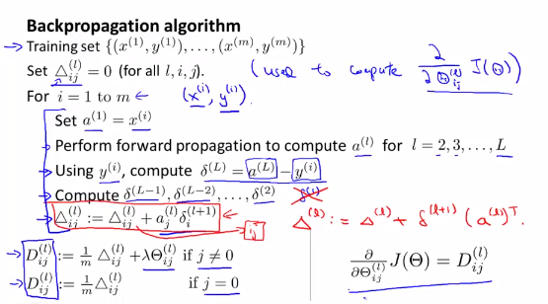
Neural Networks

Slide 42
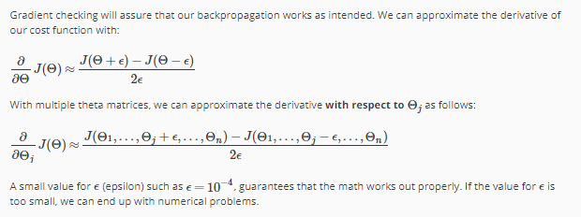
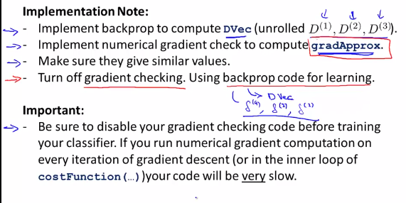
Gradient checking

Slide 43
Neural Network - Overview
Pick a network architecture - # of input units, # of output units (classes), # of hidden units per layer, # of hidden layers
Randomly initialize the weights (theta)
Implement forward propagation to get hypothesis for any x
Implement the cost function
Implement backpropagation to compute partial derivatives
Use gradient checking to confirm that the backpropagation works. Then disable gradient checking
Use gradient descent or another optimization function to minimize the cost function with weights in theta.

Slide 44
Decision Tree
Type: Parametric model,
Application: All kinds of classification problem
Learning: Build a tree top-down from a root node to leaf nodes . A tree with nodes that have a specific test and leaf nodes have the target class. 1) at node, find a test on a feature that split the training set into subsets that are as pure as possible to a given target class Use entropy (Shannon entropy or Gini index) to find optimal splits. 2) split the data by the feature (how to choose the feature) 3) each of the data-sets that splitted at the node come down to a next node. (Recursive partitioning) Repeat until stopping criteria are met.
Predictions: Pass a new sample data through each node and it finally reaches a leaf node with the target class.
Model assumptions/preparation:
Problem to solve:
Advantages: Fast, Easy to interpret, Work for both categorical and numerical data, Exploratory analysis (identifying most significant variables), less data cleaning is required, no scaling is required since this is nonparametric method
Disadvantages: Accuracy is not high. Overfitting
Hyperparameters to tune:
Tree size => Minimum samples for a node split, minimum samples for a leaf node, maximum depth of tree, maximum features to consider for split
Pruning => rpart in R provides pruning function. First step is create a fully grown tree and then prune
Key words: Entropy, Information Gain,
Notes:
https://stats.stackexchange.com/questions/44382/mathematics-behind-classification-and-regression-trees
https://jeremykun.com/2012/10/08/decision-trees-and-political-party-classification/
http://www.saedsayad.com/decision_tree.htm
Great explanation on PDF in TO628

Slide 45

Decision Trees --- Terminology

Slide 46
Random Forest
Type: Meta-algorithms approach, parametric model
Learning:
Generate artificial training set through bootstrapping WITH REPLACEMENT
Build decision tree. Randomly choose subset of features and consider them as split points (Note not all features are considered unlike bagging trees). No Pruning!
Repeat process to create multiple trees.
Prediction: The results from each of the tree are taken and the final result is decided by Voting for classification and averaging for regression.
Model Assumptions: Same to Decision Tree
Problem to solve: General. Both classification and regression problem
Advantage: Less overfitting, Useful outputs, handles unbalanced and missing data, cross validation OOB
Disadvantage: Doesn’t train well on smaller datasets. Interpretability.
Hyperparameters to tune:
Same parameters to the decision tree
Number of trees
Key words: Bagging (bootstrap aggregating), OOB
http://www.datasciencecentral.com/profiles/blogs/random-forests-explained-intuitively

Slide 47

Random forest vs. Bagging trees
Notes:
Good read: http://machinelearningmastery.com/bagging-and-random-forest-ensemble-algorithms-for-machine-learning/
https://www.quora.com/What-are-the-differences-between-bagged-trees-and-random-forests

Slide 48
RF - The out-of-bag (oob) error estimate and variable importance
In random forests, there is no need for cross-validation or a separate test set to get an unbiased estimate of the test set error. It is estimated internally, during the run, as follows:
Each tree is constructed using a different bootstrap sample from the original data. About one-third of the cases are left out of the bootstrap sample and not used in the construction of the tree.
Use the left out cases from each bootstrap sample as a test set.
The oob error estimate is given by the misclassification error (MSE for regression), averaged over all samples
Variable importance is determined by looking at how much prediction error increases when (OOB) data for that variable is permuted while all others are left unchanged.
When the training set for the current tree is drawn by sampling with replacement, about one-third of the cases are left out of the sample. This oob (out-of-bag) data is used to get a running unbiased estimate of the classification error (OOB error estimate) as trees are added to the forest. It is also used to get estimates of variable importance.
After each tree is built, all of the data are run down the tree, and proximities are computed for each pair of cases. If two cases occupy the same terminal node, their proximity is increased by one. At the end of the run, the proximities are normalized by dividing by the number of trees. Proximities are used in replacing missing data, locating outliers, and producing illuminating low-dimensional views of the data.
https://www.stat.berkeley.edu/~breiman/RandomForests/cc_home.htm

Slide 49

Ensemble
https://stats.stackexchange.com/questions/18891/bagging-boosting-and-stacking-in-machine-learning
All three are so-called "meta-algorithms": approaches to combine several machine learning techniques into one predictive model in order to decrease the variance (bagging), bias (boosting) or improving the predictive force (stacking alias ensemble). Every algorithm consists of two steps: Producing a distribution of simple ML models on subsets of the original data. Combining the distribution into one "aggregated" model. Here is a short description of all three methods: Bagging (stands for Bootstrap Aggregation) is the way decrease the variance of your prediction by generating additional data for training from your original dataset using combinations with repetitions to produce multisets of the same cardinality/size as your original data. By increasing the size of your training set you can't improve the model predictive force, but just decrease the variance, narrowly tuning the prediction to expected outcome. Boosting is a two-step approach, where one first uses subsets of the original data to produce a series of averagely performing models and then "boosts" their performance by combining them together using a particular cost function (=majority vote). Unlike bagging, in the classical boosting the subset creation is not random and depends upon the performance of the previous models: every new subsets contains the elements that were (likely to be) misclassified by previous models. Stacking is a similar to boosting: you also apply several models to your original data. The difference here is, however, that you don't have just an empirical formula for your weight function, rather you introduce a meta-level and use another model/approach to estimate the input together with outputs of every model to estimate the weights or, in other words, to determine what models perform well and what badly given these input data. Short examples of each: Bagging: Ozone data. Boosting: is used to improve optical character recognition (OCR) accuracy. Stacking: is used in classification of cancer microarrays in medicine.

Slide 50

Stacking
Stacking is a way of combining multiple models, that introduces the concept of a meta learner. It is less widely used than bagging and boosting. Unlike bagging and boosting, stacking may be (and normally is) used to combine models of different types.
The procedure is as follows:
Split the training set into two disjoint sets.
Train several base learners on the first part.
Test the base learners on the second part.
Using the predictions from 3) as the inputs, and the correct responses as the outputs, train a higher level learner.
The combining mechanism is that the output of the classifiers (Level 0 classifiers) will be used as training data for another classifier (Level 1 classifier) to approximate the same target function. Basically, you let the Level 1 classifier to figure out the combining mechanism.

Slide 51


K-nearest neighbors
https://kevinzakka.github.io/2016/07/13/k-nearest-neighbor/
https://brilliant.org/wiki/k-nearest-neighbors/ for pos/cons
Use case: Computer vision, recommender systems
Assumptions: Feature requires scaling as this is distance-based algorithm
Learning: The algo doesn’t explicitly learn a model. Instead, it memorize the training instances which are subsequently used as knowledge for the prediction phase (lazy learner).
Prediction:
Similarity is defined according to a distance metric between two data points. A popular choice is the Euclidean distance:
The KNN classifier is also a non parametric and instance-based learning algorithm.
Pros: Easy to interpret output, calculation time, predictive power, can handle extreme multi class problems
Cons: Expensive and slow to predict new instances. Requires dimension reduction (more than 10)
Parameters to tune: K smaller => overfitting, larger => high bias

Slide 52
K-Nearest Neighbor
Type: Distance-based algorithm, lazy learner, instance-based learning algorithm
Representation: NA
Learning: The model doesn’t explicitly learn the data. Instead, it memorizes the training instances which are subsequently used as knowledge for prediction phase.
Predictions:
Compute distance between new data-set x and training observations. We call the k points in the training data that are closest to x the set A. (Note that K is usually odd to prevent situations)
Input x gets assigned to the class with the largest number of votes.
Model assumption/preparation: Feature scaling.
Problem to solve: Computer vision, recommender systems
Advantages: Easy to interpret, predictive power, can handle extreme multi-class problems
Disadvantages: Expensive and slow to predict new instances. Requires dimension reduction. Sensitive to outlier. Doesn’t handle categorical data well.
Hyperparameters to tune:
K: number of neighbors. Smaller k leads to overfitting(variance) while larger k leads to high bias.
Distance function:
Key words:

Slide 53


Slide 54


Distance Metrics
Distance “Measure” can be anything
Distance metric is specific

Slide 55



Clustering – K-Means Algorithm
Application: market segmentation, social network analysis
How: Create two clusters
Step0: Randomly initialization: pick two points, called the cluster centroids.
Step1: Cluster assignment. Go through each examples and assign each to one of the two cluster centroids, depending on whether it is closer to either of the two.
Step2: Move cluster centroid. Take the two cluster centroids and move to the average of the points that belong to the same cluster.
Iterate step 1 and 2 till the parameters converges.
Distance-based algorithm
Avoid local optima: use multiple random initializations
Choose K: check visualizations of different K and pick it by hand. Elbow method
Step 0
Step 1
Step 2

Slide 56

K-means algorithm

Slide 57
Clustering: K-means vs. Gaussian maximization model
Reference: https://www.quora.com/What-is-the-difference-between-K-means-and-the-mixture-model-of-Gaussian
K-means
Gaussian maximization model
Advantages
Running time
Better for high dimensional data
Easy to interpret and implement
Disadvantages
Assumes the clusters as spherical, so does not work efficiently with complex geometrical shaped data (Mostly Non-Linear)
Hard Assignment might lead to miss-grouping
Hard Assignment: It classifies samples into K number of clusters. Clustering of samples is done by minimizing the distance between samples and the centroid.
Advantages:
Works well with non-linear geometric distributions as well
Does not bias the cluster sizes to have specific structures as does by K-Means
Disadvantages:
Consumes memory. Uses all the components it has access to, so initialization of clusters will be difficult when dimensionality of data is high
Difficult to interpret
Soft Assignment: No assignment for a number of clusters. This uses probability of a sample to determine the feasibility of it belonging to a cluster.
The silhouette coefficient for a data point measures how similar it is to its assigned cluster from -1 (dissimilar) to 1 (similar). Calculating the mean silhouette coefficient provides for a simple scoring method of a given clustering.

Slide 58

Dimensionality Reduction - Part.1
Why?: Motivation1: Speed up algorithms. Reduce space used by data for them. Motivaition2: Visualization. It’s hard to visualize high dimensional data. Motivation3: Less computer memory or disk space usage.
What? Principal Component Analysis
How? A linear mapping of the data to a lower-dimensional space.
E.g. 1000D => 100D
Fit a straight line to minimize the VERTICAL distance between a point and a line(For linear regression, minimize a straight line between a point and a line)
Side note: You should normally do mean normalization and feature scaling.

Slide 59


Principal Component Analysis
Problem formulation: Reduce from n-dimension to k-dimension: find k vectors(subspace) onto which to project the data, so as to minimize the projection error.
It's trying to find a lower dimensional surface onto which to project the data, so as to minimize this squared projection error. To minimize the square distance between each point and the location of where it gets projected. In the next video, we'll start to talk about how to actually find this lower dimensional surface onto which to project the data.
Key words: reconstruction from compressed representation. Choosing the number of principle components.
Reference: http://webspace.ship.edu/pgmarr/Geo441/Lectures/Lec%2017%20-%20Principal%20Component%20Analysis.pdf
https://onlinecourses.science.psu.edu/stat505/node/54
http://setosa.io/ev/principal-component-analysis/

Slide 60


Slide 61

PCA algorithm
Compute “covariance matrix”
Compute “eigenvectors” of matrix sigma
SVD
https://www.quora.com/Why-is-SVD-considered-a-highlight-of-linear-algebra
http://freevideolectures.com/Course/2052/Linear-Algebra/30

Slide 62

Choosing k
Xx% of variance is retained

Slide 63

Caution!
Before implementing PCA, first try running whatever you want to do with the original/raw data. Only if that doesn’t do that you want, then implement PCA and consider using z(i)
Bad use of PCA: to prevent overfitting. It might work. But use regularization instead

Slide 64

PCA Assumptions

Slide 65



PCA --- example The most challenging part of PCA is interpreting the components

Slide 66


Curse of dimensionality
http://courses.cs.tamu.edu/rgutier/cs790_w02/l5.pdf
As the number of features or dimensions grows, the amount of data we need to generalize accurately grows exponentially

Slide 67



Anomaly detection
And a key difference really is that in anomaly detection, often we have such a small number of positive examples that it is not possible for a learning algorithm to learn that much from the positive examples.
Do later: Multivariate Gaussian

Slide 68




Recommender systems

Slide 69

Naïve Bayes
Type: Probability-based model
Representation:
Learning:
Describe probability of class C given the features provided
Compute parameters to maximize the probability of getting the features given class C (MLE)
Predictions:
With the new dataset,
Model assumption/preparation: 1) “Naïve” assumptions are that all of the features in the dataset are equally important and independent. 2) Each feature must be categorical in order to create the combinations of class and features values comprising the matrix. One easy solution is to discretize numeric features. (binning)
Problem to solve: Text classification, Spam detection, Real time prediction
Advantage: Simple, fast (easy to parallelize, just to count), does well with noisy and missing data, Good for small/large number of examples. Able to obtain probability for a prediction
Disadvantage: Not ideal for datasets with large number of numeric features, relies on an faulty assumption of equally important and independent features
Hyperparameters to tune:
Key word: Laplace smoothing, Calibration if interested in probability for a prediction
Notes:
https://brilliant.org/wiki/naive-bayes-classifier/
http://www.cs.ucr.edu/~eamonn/CE/Bayesian%20Classification%20withInsect_examples.pdf
http://scikit-learn.org/stable/modules/naive_bayes.html

Slide 70


Naïve Bayes --- Example
https://software.intel.com/en-us/articles/mathematical-concepts-and-principles-of-naive-bayes

Slide 71

Naïve Bayes – Laplace estimator

Slide 72
Work Flow of Data Science Project
Ask an interesting question
What is the goal?
What would do if you had all the data?
What do you want to predict or estimate?
Get the data
How were the data sampled?
Which data are relevant?
Are there privacy issues?
Explore the data
Plot the data
Are there anomalies?
Are there patterns?
Model the data
Build a model
Fit the model
Validate the model
Communicate and visualize the results
What did we learn?
Do the results make sense?
Can we tell a story?
Joe Blitzstein and Hanspeter Pflister, created for the Harvard data science course

Slide 73


Work Flow --- Andrew Ng
=> Decide what to do next

Slide 74


Learning Curves
Error curves or accuracy score curves are plotted against an increasing number of samples on the x-axis.
Error curves or accuracy score curves are:
Train error ( or accuracy score): the trained model applied on the training data itself
Validation error (or accuracy score): cross validation performed on the training set
Both curves flatten at some point.
Learning curves are useful to build an optimal model because the curves detect overfitting/underfitting and suggest what to do to optimize a model. (e.g. larger training set will help or not)

Slide 75


Bias and Variance
Prediction errors can be decomposed into two main subcomponents: error due to bias and error due to variance.
Bias: When the model is relatively simple, prediction errors occurs due to bias / under-fitting. This is because the model is so simple that doesn’t capture the complexity of between target value and features.
Variance: As the model increase its complexity, prediction errors occurs due to variance / over-fitting. The model fits the data set provided but doesn’t perform on new data.
Trade-off: there is a tradeoff between a model’s ability to minimize bias and variance.
Bias comes from model.
Variance comes from data
Reference: http://scott.fortmann-roe.com/docs/BiasVariance.html

Slide 76


Slide 77


Slide 78


Slide 79


Performance metrics summary
Kappa
Logarithmic Loss (log loss)
Adjusted R-squared
Multiple R-squred
AIC, BIC

Slide 80

Confusion Matrix
A confusion matrix is a table that is used to describe the performance of classification model on a set of test data for which the true value are known
True positives: The model predicts positive which is aligned with the target.
True negatives: The model predicted negative which is aligned with the target.
False positives: The model predicts positive but the target is actually negative.
False negative: The model predicts negative but the target is actually positive.
Accuracy = TP + TN / total
Overall, how often is the classifier correct?
Precision = TP / predicted positive
When it predicts positive, how often is it correct?
Recall(=Sensitivity) = TP / actual positive
When it’s actually positive, how often does it predict yes?
Note: Recall is also referred to as the true positive rate or sensitivity
Reference: https://www.quora.com/What-is-the-best-way-to-understand-the-terms-precision-and-recall
http://www.dataschool.io/simple-guide-to-confusion-matrix-terminology/

Slide 81
Confusion Matrix - Example
Caes1: Marketing campaign
Look for a target customer for marketing campaign. A target customer is very few vs. entire customer
Recall: TP/ Actual Positive (TP + FN) matters because a company to capture as many target customer as possible. In other words, capture as many actual positive as possible. FN (who is positive but predicted as negative) should be minimum.
Precision: TP/Predicted Positive(TP+FP) might help reduce marketing cost by narrowing prediction.
Caes2: Cancer diagnosis
Precision: TP/ Predicted Positive (TP + FP) matters because prediction (diagnosis) matters. Wrong cancer diagnosis (FP) can be very problematic for a patient and a doctor.
How about false negative (a patient who has cancer but not diagnosed yet). Yes. It’s important.
Thus, both recall and precision matters

Slide 82
Shortcomings of accuracy measurements
Not ideal for skewed classes
Doesn’t work when want to err on side of guessing positive
E.g. Criminal prosecution
Doesn’t work when want to err on side of guessing negative
E.g. Fraud detection for credit card
 | Characteristics | Valuable indicators
Criminal prosecution | Want to minimize people who wrongly prosecuted (false positive). | Precision = TP / predicted positive (FP + TP) Minimizing FP improves this score
Fraud detection for credit card | Want to minimize fraud cases that are left undetected (false negative). | Recall = TP / actual positive (FN + TP) Minimizing FN improve this score
Accuracy paradox: it is the case where your accuracy measures tell the story that you have excellent accuracy (such as 90%), but the accuracy is only reflecting the underlying class distribution! Naïve prediction can achieve the same accuracy

Slide 83


ROC Curve
http://machinelearningmastery.com/assessing-comparing-classifier-performance-roc-curves-2/
Usage: Assess classifier performance and threshold selection
Classifier produce a score, which is then thresholded to decide the classification. If a classifier produces a score between 0.0 (definitely negative) and 1.0 (definitely positive), it is common to consider anything over 0.5 as positive.
TP rate = sensitivity = TP / Actual Positive
FP rate = 1- specificity = 1 – TN / Actual Negative = FP / Actual Negative
Draw a ROC curve: Start with a threshold of 0.0, so that every case is considered as positive. We correctly classify all of the positive cases, and incorrectly classify all of the negative cases. We then move the threshold over every value between 0.0 and 1.0, progressively decreasing the number of false positives and the number of true positives
For A perfect classifier the ROC curve will go straight up the Y axis and then along the X axis. (100% TP rate and zero FP rate )
A classifier with no power, random guessing is a diagonal line from left bottom to right top
AUC: area under the curve.

Slide 84

F1 score and F beta score
The F1 score can be interpreted as a weighted average of the precision and recall, where an F1 score reaches its best value at 1 and worst at 0:
F1 = 2 * (precision * recall) / (precision + recall)

Slide 85


Overfitting
Overfitting refers to a model that fits the training data too well, but fail to generalize to new examples.
Overfitting occurs when a model is excessively complex, such as having too many parameters.
A model describes random error or noise instead of the underlying relationship.
Cross validation is a useful technique to prevent overfitting.
Addressing overfitting:
Reduce number of features
Manually select which features to keep
Model selection algorithm
Regularization
Keep all the features magnitude/values of parameters theta. (works well when we have a lot of features, each of which contributes a bit to predicting y)

Slide 86

Complexity Curves
Complexity curves are similar to learning curves. They plot error curves or accuracy score curves against an increasing complexity (usually in parameter of a model)
Train error ( or accuracy score): the trained model applied on the training data itself
Validation error (or accuracy score): cross validation performed on the training set
The curves are useful to find out an optimal model.
Validation error or score flatten at some point while training error or score continue to improve. Widening gap between the two curves suggests overfitting of a model

Slide 87


k-fold Cross Validation
K-fold CV is a technique to split data into k-subsets, and to uses one subset to test the model and the rest of the data to train and test is conducted k times.
The results from the folds can then be averaged to produce a single estimation.
This technique is useful to prevent overfitting
Refer: Out-of-bag error estimate
This is purely method of measuring accuracy. Usually, we use training data set to build a final model, separately.

Slide 88

Regularization
Small values for all parameters
Simpler hypothesis
Less prone to overfitting

Slide 89





L1 and L2 regularization
L2: Ridge regression
L1: LASSO(Least Absolute Shrinkage and Selection Operator) regression
http://www.chioka.in/differences-between-l1-and-l2-as-loss-function-and-regularization/
https://www.quora.com/What-is-the-difference-between-L1-and-L2-regularization-How-does-it-solve-the-problem-of-overfitting-Which-regularizer-to-use-and-when
https://www.analyticsvidhya.com/blog/2016/01/complete-tutorial-ridge-lasso-regression-python/ (best)

Slide 90


Ceiling Analysis
Motivation: Decide what parts of the pipeline might be the best use of your time to work on
Step by step
1. Go to a component of the pipeline and manually provide a correct answer for each test set so that as if I have a perfect performance on my test set.
2. Run this data through the rest of the pipeline. Use the same evaluation metric before to measure what is the overall accuracy of the entire system and gauge the improvement.
3. Go to another component of the pipeline and do the same: provide a correct answer and measure the overall accuracy and the improvement.
4. Pick a component which shows the largest improvement to work on.

Slide 91
Data Exploration Cheat Sheet
Data exploration overview:
Data exploration serves some important objectives. For this exploration, we focus on understanding the data-set in order to decide
1 . What algorithm we select
2. What variables we use for algorithm training and prediction
3. What transformation are required for each variables based on the choice of algorithm
Note that since we have spend significant amount of time for data cleaning and feature creation in the preprocessing phase, this data exploration doesn’t cover these items.
First step:
Before diving into detailed analysis, it is good to start with a high level picture. In this section, we look at summary statistics to see distribution of each variable, check a variable category (such as category/continuous) for variables, and validate NA values in each column.
Univariate analysis:
Investigate distribution of key variables that we are interested in using for the recommendation engine. If a variable is extremely skewed, we might need to consider transformation. In this analysis, we focus on five variables: 1) year founded, 2) funding round, 3) money raised, 4) company size, 4) country and 5) headquarter location.
Bivariate analysis:
Analyze the relationship between two variables. Usually it serves two purposes: 1) look at the association between independent variables (explanatory variable) and target variable (in our case, CompanyName) in order to select variables to include in a model to build 2) look at the associations among independent variables to remove highly correlated variables from the inputs for the model. Since our problem is extreme multiclass classification problem where each example has different target variable company, we don’t run the analysis 1) described above. Instead, we focus on analysis 2). Specifically, we look at the relationships for the following variable combinations.
Company size x Year Founded
Company size x Money Raised
Funding round x Money raised
Location x Money Raised
Location x Specific industries
Scatterplot matrix
When we have a large number of variables, we often begin with a scatterplot matrix. This is helpful for getting a high-level overview of the relationships between our variables and can draw our attention to important features we want to investigate further.
Conclusion
Follow up the objectives set at the beginning of this data exploration.
**- Algorithm selection**
Choose K-Nearest Neighbor for this problem because this is a multiclass classification problem where each example of training data has different target label (CompanyName). Also, the sample size is quite small for now. This is good for KNN.
**- feature selection**
KNN requires dimension reduction because it doesn't handle multidimensional space well. Thus, we need to select some variables that really matters for the model to make predictions. I selected following variables based on bi-variate analysis: money_raised, company_size, location, year_founded, and industry.
**- feature transformation**
KNN assumes each feature to be a numerical variable and scaled properly because KNN is a distance-based algorithm which calculate distance between each test sample and each training test example. It's also important to note that KNN is sensitive to outliers because again it's distance-based algorithm. Given these in mind, we need to make following feature transformations for each variables we selected as the model inputs.
- Money_raised - log transformation for outlier handling and min-max transformation
- Company size - Binning and min-max transformation
- Location - latitude and longitude of cities and min-max transformation for them
- Year Founded - removal of outliers and min-max transformation
- Industry - dummy variable transformation (already done)

Slide 92
Handling of imbalanced data
http://machinelearningmastery.com/tactics-to-combat-imbalanced-classes-in-your-machine-learning-dataset/
Performance matrix – confusion matrix, F1 score, kappa, ROC Curves
Resampling – oversampling, under-sampling stratified sampling
Generate synthetic samples
Different algorithms: Anomaly detection. Change detection
Penalized models
https://elitedatascience.com/imbalanced-classes

Slide 93



Outlier treatment
http://www.theanalysisfactor.com/outliers-to-drop-or-not-to-drop/
If it is obvious that the outlier is due to incorrectly entered or measured data, you should drop the outlier:
If the outlier does not change the results but does affect assumptions, you may drop the outlier. But note that in a footnote of your paper.
More commonly, the outlier affects both results and assumptions. In this situation, it is not legitimate to simply drop the outlier. You may run the analysis both with and without it, but you should state in at least a footnote the dropping of any such data points and how the results changed.
If the outlier creates a significant association, you should drop the outlier and should not report any significance from your analysis.

Slide 94

Outlier detection – Turkey Method
http://datapigtechnologies.com/blog/index.php/highlighting-outliers-in-your-data-with-the-tukey-method/

Slide 95
Centering and scaling
Min/Max scaling
Centering transformation is basically reducing the Mean value of samples from all observations. So, the observations will have a mean value of Zero after this transformation. Scaling transformation is dividing value of predictor for each observation by standard deviation of all samples. This will cause the transformed values to have a standard deviation of One.
When & Why we need Centering & Scaling (Standardization):
Standardization is recommended when regression models are being built. When there are predictors with different units and ranges, the final model will have coefficients which are very small for some predictors and it makes it difficult to interpret
Centering & Scaling will improve the numerical stability of some models(i.e PLS)
Many predictive modeling techniques use the predictor variance as an important factor for assigning importance to each predictor(PLS,…). In this situation, since variables with larger units usually have higher variance compare to predictors which have smaller units, the models will favor variables with larger units. The Centering & Scaling transformation ensures that unit differences don’t impact predictor selection and final model.
For penalized models in regression (Lasso, Ridge Regression,…) the penalty is calculated based on estimated coefficient for each parameter. So, centering and scaling is critical for those models because otherwise predictors with smaller units will receive lower cost and the model will be impacted

Slide 96

Not 100% correct but good to refer
Notes:
http://www.dataschool.io/comparing-supervised-learning-algorithms/
https://stats.stackexchange.com/questions/189652/is-it-a-good-practice-to-always-scale-normalize-data-for-machine-learning

